Slide 1
Developing a common components Angular library
Giannis Smirnios

Slide 2
why do we need a library
The quintessence of a programmer:
trying to be lazy

Slide 3
why then it isn’t done more often
Poor documentation
Few sources online
No CLI until now
Needed to understand deeply typescript packaging and distribution
Poor, slow and unreliable way to test the lib

Slide 4

building a library with Angular CLI
Workspaces
Let’s create a workspace
ng new ang-ath-lib-app

Slide 5
building a library with Angular CLI
Let’s create a library
ng generate library ang-ath-lib

Slide 6
building a library with Angular CLI
Let’s create a component inside the library
ng generate component foo --project=ang-ath-lib

Slide 7
building a library with Angular CLI
Note: rebuild your library after making changes
Note: we now have 3 package.json files
root package.json
library package.json
library distribution package.json
Note: assets can be included!

Slide 8
making it happen
Design
Develop
Deploy

Slide 9
design – develop - deploy
Separation of Concerns
https://en.wikipedia.org/wiki/Separation_of_concerns
Should be the pattern to always follow while choosing what and how to include things in the library

Slide 10
design – develop - deploy
Understand which components are specific to your business and which are generic
A way to approach this:
application specific
project specific
business specific
open source worthy

Slide 11
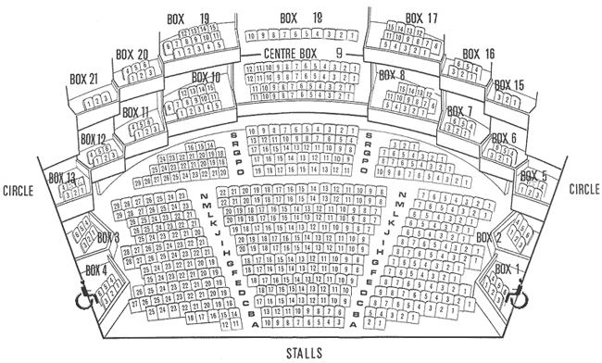
design – develop - deploy
Application specific component:

Slide 12


design – develop - deploy
Project specific component:
<theater [rows]="4" [columns]="22" ></theater>
<theater [rows]="5" [columns]="23" ></theater>

Slide 13


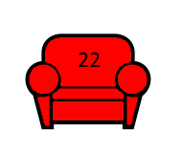
design – develop - deploy
Business specific component:
Free
Reserved
Booked

Slide 14
design – develop - deploy
Open source worthy component:
<svg-color-filler [image]="image" [color]="#FF0000">
</svg-color-filler>

Slide 15
design – develop - deploy
application specific – usually not library worthy
project specific – business oriented library worthy
business specific – business oriented library worthy
open source worthy – common library worthy

Slide 16
design – develop - deploy
decide how much to break down the components
having a component perform a complex or specific task isn't always bad!

Slide 17
design – develop - deploy
The biggest drive in development should always be to make the library maintainable

Slide 18
design – develop - deploy
Clearly define inputs/outputs of the component/services/pipes
Avoid having a lot of inputs
Break the components into smaller ones or use a properties object
Don’t use objects for everything either

Slide 19
design – develop - deploy
Clearly define inputs/outputs of the component/services/pipes
Avoid having a lot of inputs
<p-table [columns]="cols" [value]="cars" [lazy]="true" (onLazyLoad)="loadCarsLazy($event)" [paginator]="true" [rows]="10" [totalRecords]="totalRecords" [scrollable]="true" scrollHeight="200px" …etc

Slide 20
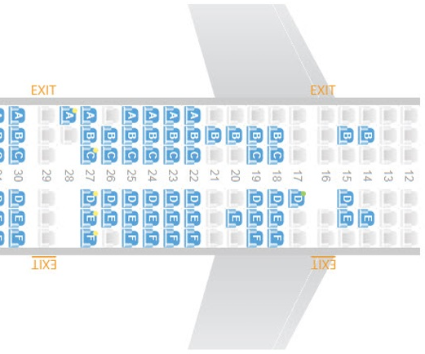
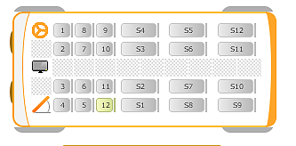
design – develop - deploy
Clearly define inputs/outputs of the component/services/pipes
Avoid game changing ifs inside the component:
maybe this is a sign that two separate components must be created

Slide 21
design – develop - deploy
The component should publish events regarding its status, even if they don’t seem useful in your application
@Output() onTodayClick: EventEmitter<any> = new EventEmitter();
@Output() onMonthChange: EventEmitter<any> = new EventEmitter();

Slide 22
design – develop - deploy
Force maintainability:
Compodoc with big % code coverage
Linter with commit hook
Unit testing in all components
calendar.spec.ts
Designate someone responsible for pull requests in the library

Slide 23
design – develop - deploy
Main goal is developing and deploying the library in parallel with your work

Slide 24
design – develop - deploy
step 0: make sure that your build and delivery process can support a common library

Slide 25
design – develop - deploy
step 0: make sure that your build and delivery process can support a common library
where the code will be published?
Does your company has a private npm repo
Jfrog / Yarn / GIT
Make it opensource
npm pack to .tgz and distribute locally

Slide 26
design – develop - deploy
step 0: make sure that your build and delivery process can support a common library
Do you deliver the source code to the customer? If so how it is planned to deliver the common library code
Is there an automated build (for ex. Jenkins) that requires access to the common library?

Slide 27
design – develop - deploy
step 0: make sure that your build and delivery process can support a common library
Push for this step 0 to happen! Besides the advantages of a common angular library, unblocking the use of it will streamline other processes in your organization as well

Slide 28
design – develop - deploy
Extract common components inside a single application without the library
Bring code in line between applications without the library
Create the library having only a single simple component
Use the library's component in one of your applications to verify step 0

Slide 29
design – develop - deploy
5. Pull all components/services/pipes etc. to the library
6. Start using the library in the smallest / lowest risk application (Replace all components/services/pipes etc. from your application with the library ones)
7. Use it everywhere :-)

Slide 30
design – develop - deploy
After competing it the library should be advertised to architects/senior developers and forced – at least in the new projects

Slide 31
design – develop - deploy
Effort should regularly and officially consumed in maintenance:
Bug-fixing library's component/services/pipes (project effort)
Adding new features as they arise from development (project effort)
Releasing new versions of the library in line with major angular releases (library effort)

Slide 32
design – develop - deploy
Releasing new versions of the library (cont.)
It is important to decide when and if it does makes sense to update the library
does the latest angular break the library?
does the latest angular helps significantly the library?
does the latest angular makes a part of the library obsolete?
is the latest angular ever going to supported in our projects? This should not be a question! Avoid tech debt!
https://en.wikipedia.org/wiki/Technical_debt

Slide 33
summary
Angular CLI library
How to design the library
How to develop the library and it’s components
How to deploy the library on your projects

Slide 34
Thank you!
Message me at twitter: @GiannisSmirnios or at Angular Athens slack!
Sources
Angular CLI by Google https://cli.angular.io
Todd Palmer @ medium.com
https://blog.angularindepth.com/creating-a-library-in-angular-6-87799552e7e5
Angular CLI story: Hans Larsen @ github
https://github.com/angular/angular-cli/wiki/stories-create-library
Theatre booking example
http://www.forumtheatrebillingham.co.uk/seating-plan.html
http://www.dominicmusgrave.co.uk/portfolio/
https://www.iconfinder.com
https://primefaces.org/primeng
http://www.travelcarma.com/online-bus-reservation-system.htm
https://www.travelport.com/solutions/travelport-smartpoint/tips_tricks

